Slide 1
P230 Patient’s Condition Classification
Using NLP and Supervised ML Algorithms

Slide 2
Team 5
Mr. Vishwanath M Irkal
Mr. Riyaz Ahemed Shaik
Mr. JOYDEEP DEKA
Mrs. Yamini Vinod Bansode
Mrs. Lavanya Nalla
Mr. M Guru Bhavan Narayana
Mentor : Madishetti Rajashekar

Slide 3
Objective of the Project
To predict (or Classify) the Patient’s condition based on Reviews(input) Using NLP and Supervised ML techniques.
Recommending Medicines based on the predicted Condition.
There are 3 conditions(target) we need to classify i.e.
Depression
High Blood Pressure
Diabetes Type 2

Slide 4
Steps Followed:
Data Collection and Data Description.
EDA Summary.
EDA Visualizations.
Text Pre-processing.
Feature Extraction.
Model Building and Models Summary.
Challenges Faced.
Final Deployment.

Slide 5
Data Collection and Data Description
The data set was provided to us by our Institute,
Name of the dataset:
drugsCom_raw.tsv

Slide 6
Data Description:
The dataset consists of 6 features i.e.
1. DrugName (categorical) → name of drug
2. condition (categorical) → name of condition
3. review (text) → patient review about the medicine
4. rating (numerical) → 10 star patient rating
5. date (date) → date of review entry
6. usefulCount (numerical)→ number of users who found review useful

Slide 7
3. EDA SUMMARY
Data Checking:
There are NO Null values.
There are No Nan Values.
There are NO duplicate observations.
Data Understanding:
There are different types of data present in the dataset i.e. Drug Name is Nominal, Condition(Which is our target variable) is Categorical, Review is Text, Rating is Ordinal Numerical (1-10) and useful Count is Discrete Numerical.
Drug Name feature has 334 unique drugs, only 60 drugs appeared more then 50 times in the dataset, 183 drugs appeared less then 10 times and 62 drugs appeared only once.
Useful Count has values ranging from 0 to 1291 and the Median value is at 31. This means the data is highly left skewed. From the distribution plot, very few observations got more then 200 useful Count.
If we take rating>5 as positive sentiment and rating<-5 as negative sentiment then the distribution of sentiments shows 70% positive and 30% negative sentiment.

Slide 8
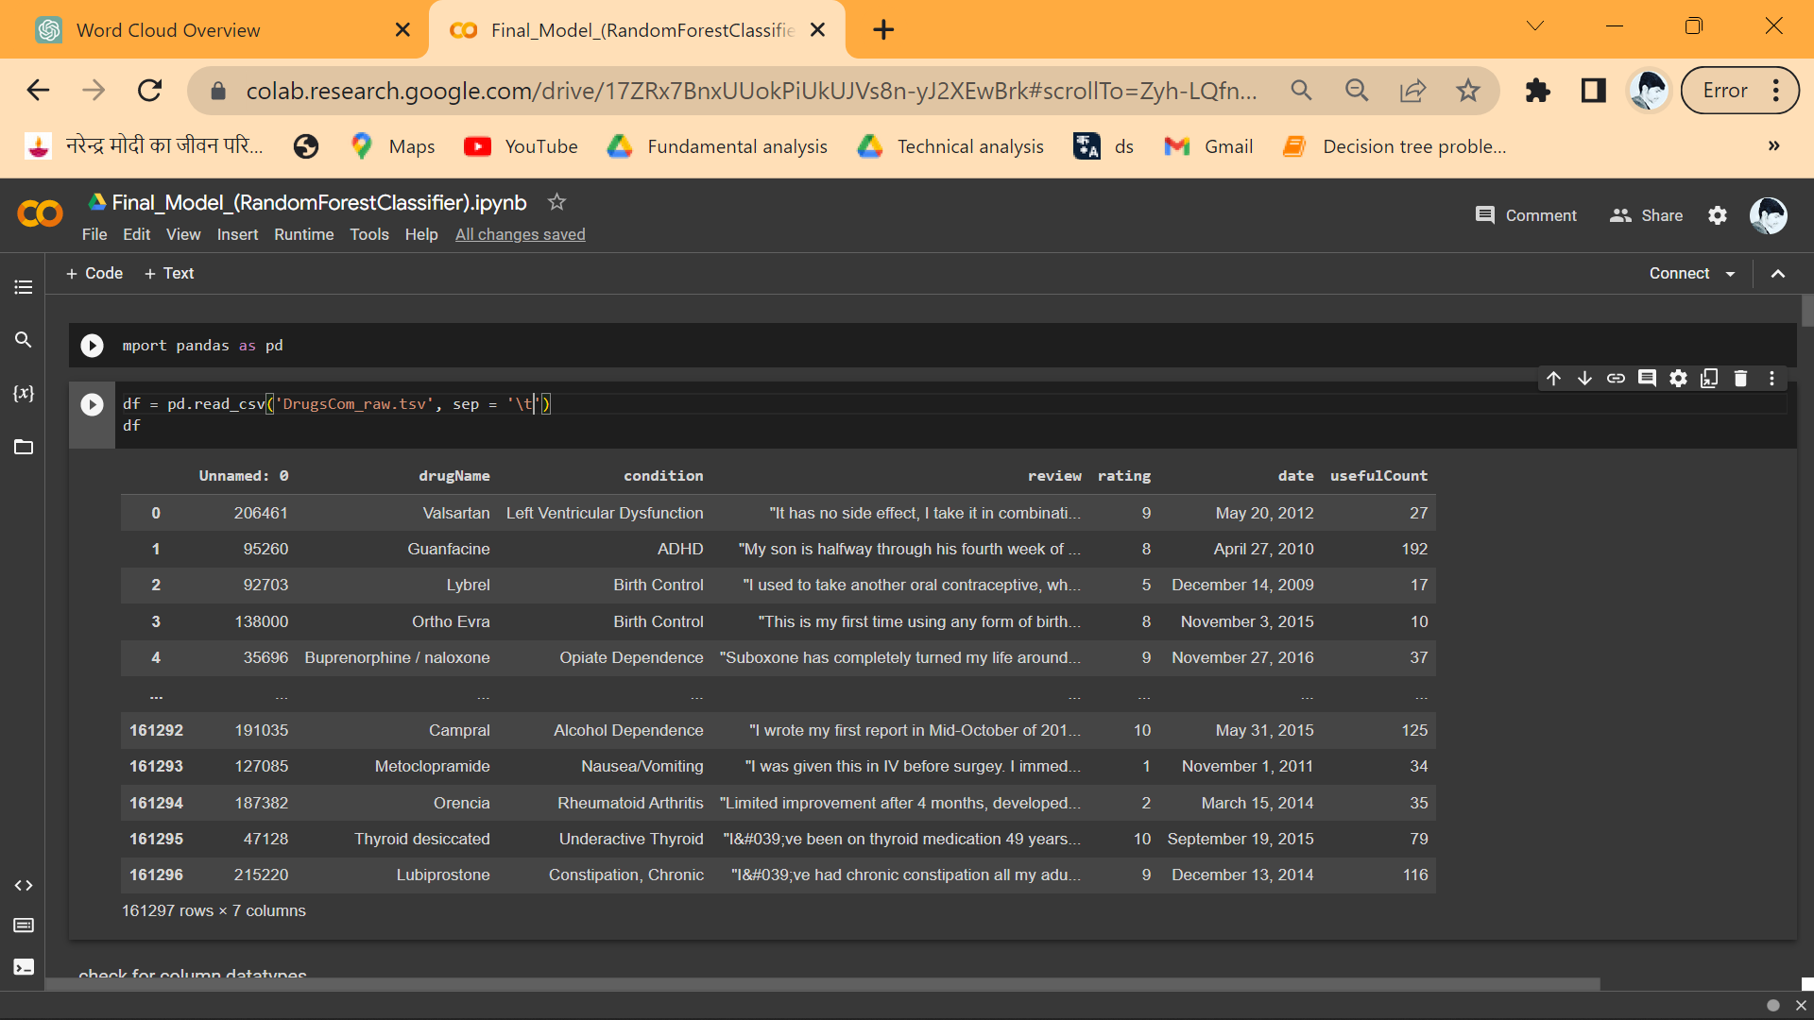
The original dataset consists of 161297 observations. Here the condition column has many conditions which includes our desired 3 conditions i.e. Depression, High Blood Pressure and Diabetes Type 2.

Slide 9
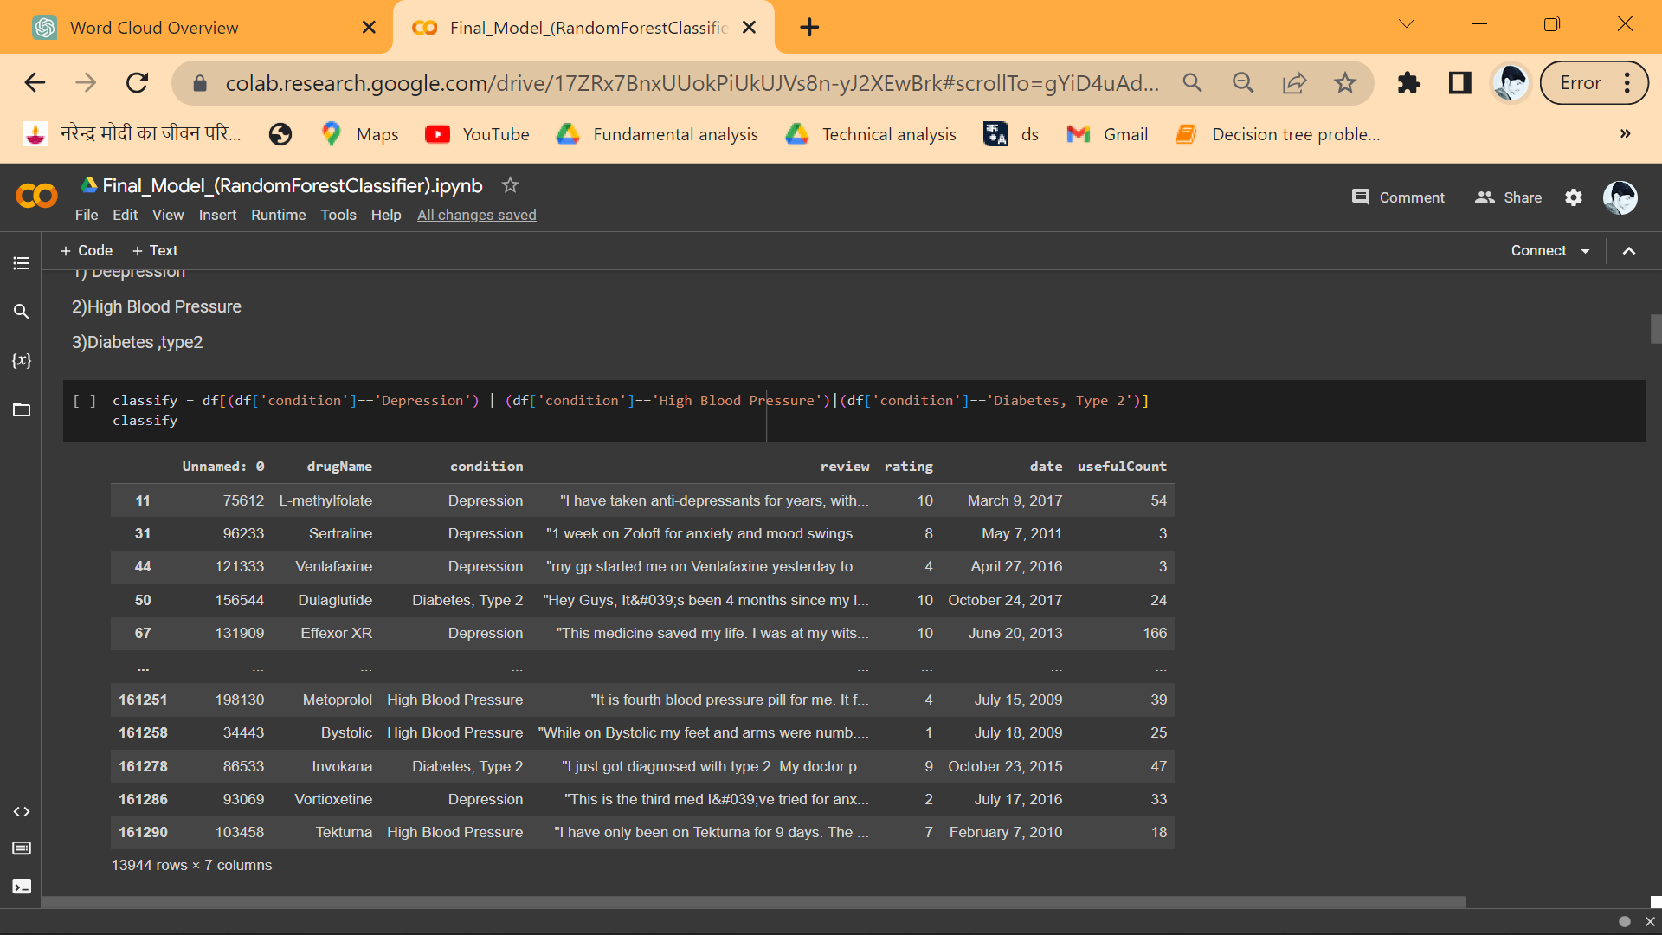
Extracting data with specific conditions (Depression, High Blood Pressure, Diabetes, Type 2) Here we have 13944 observations.

Slide 10
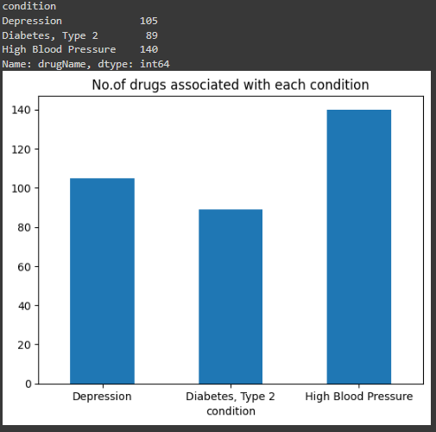
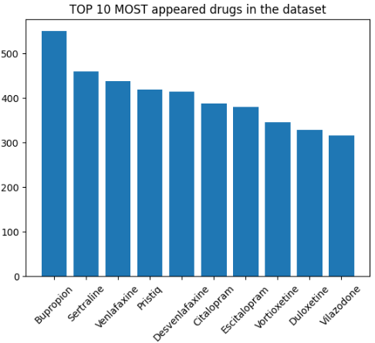
3. EDA Visualizations

Slide 11
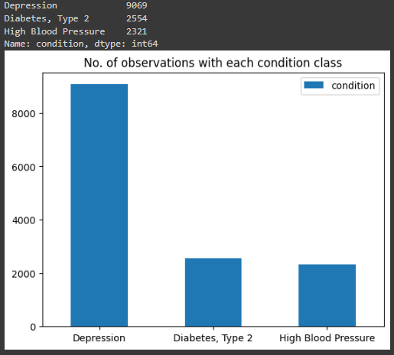
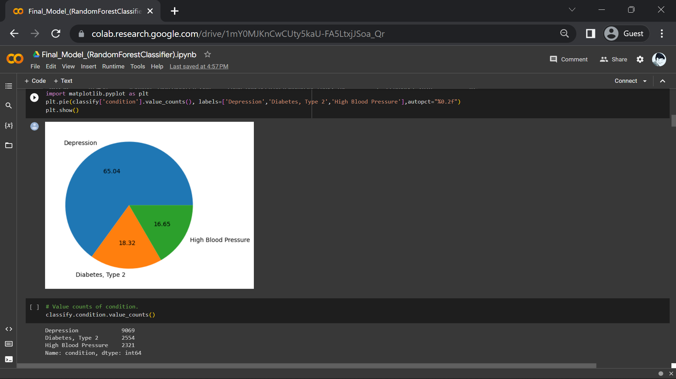

Slide 12
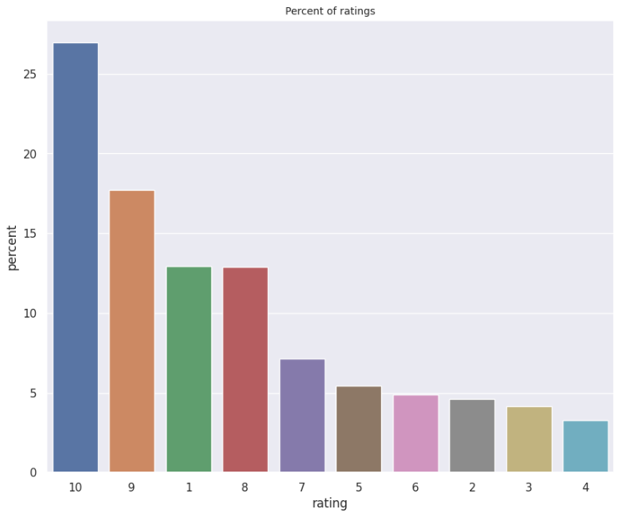
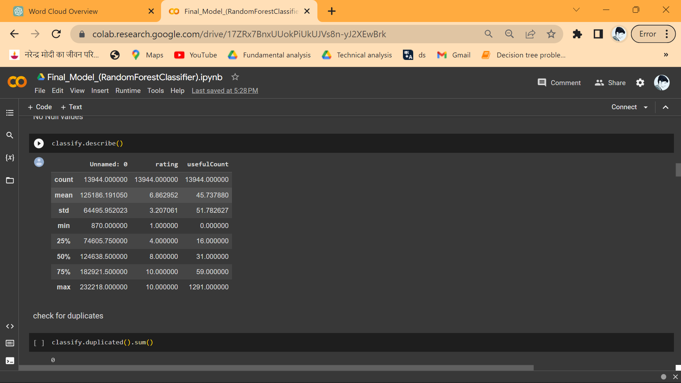
Frequency distribution of rating
Discerption of the data
Regarding the 3 conditions

Slide 13
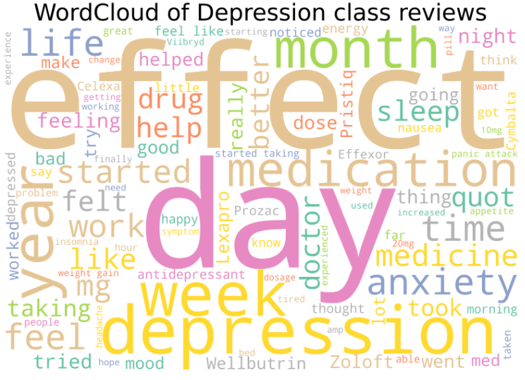
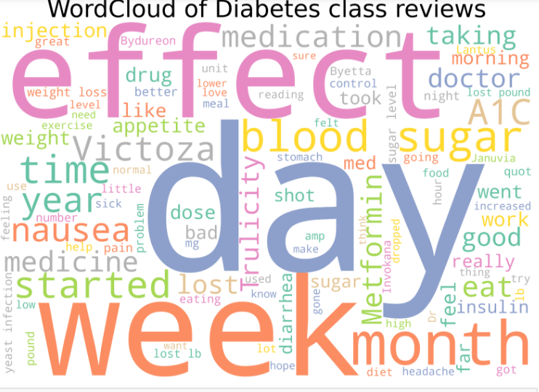
World-Colud for the three conditions

Slide 14
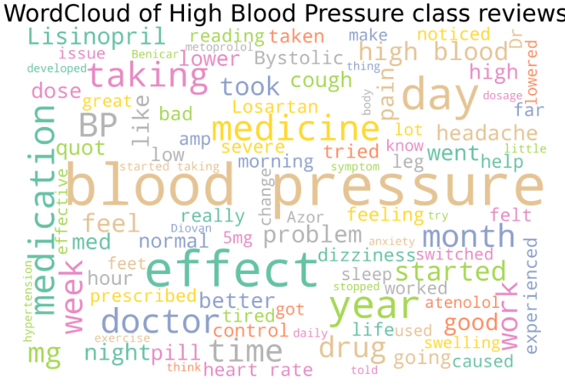
Word cloud is a visual representation of text data where the size of each word indicates its frequency or importance. It helps identify key themes or patterns in a document or corpus at a glance. By visually highlighting popular or significant words, word clouds provide a quick overview of textual information

Slide 15
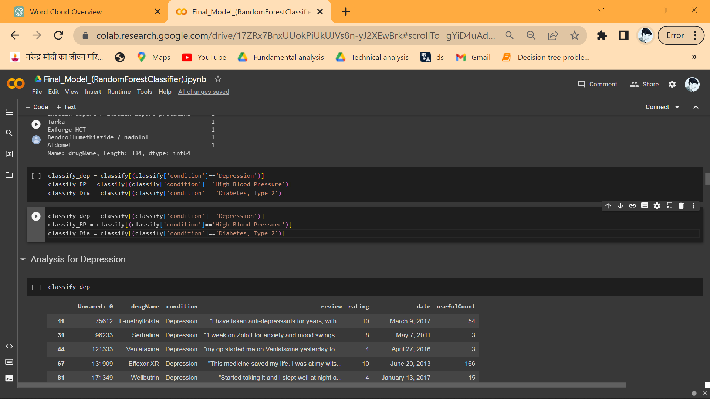
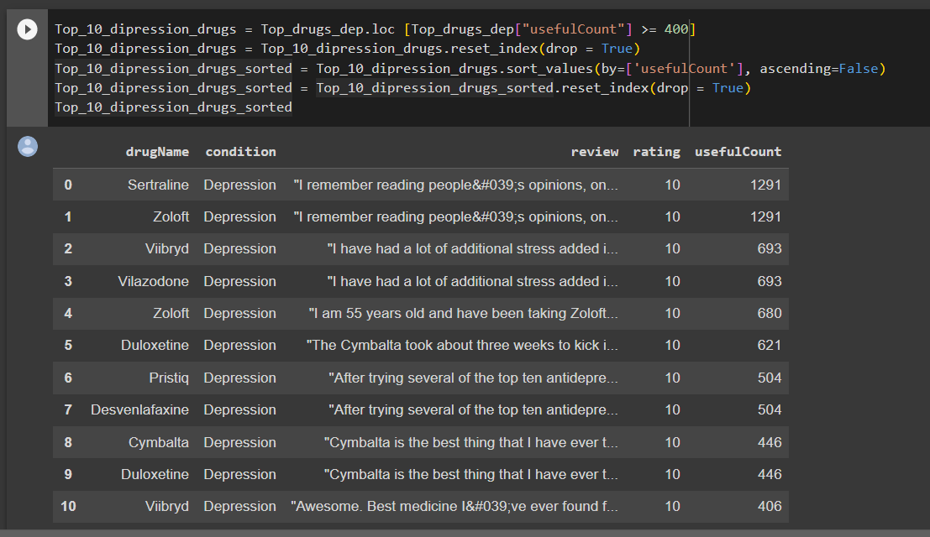
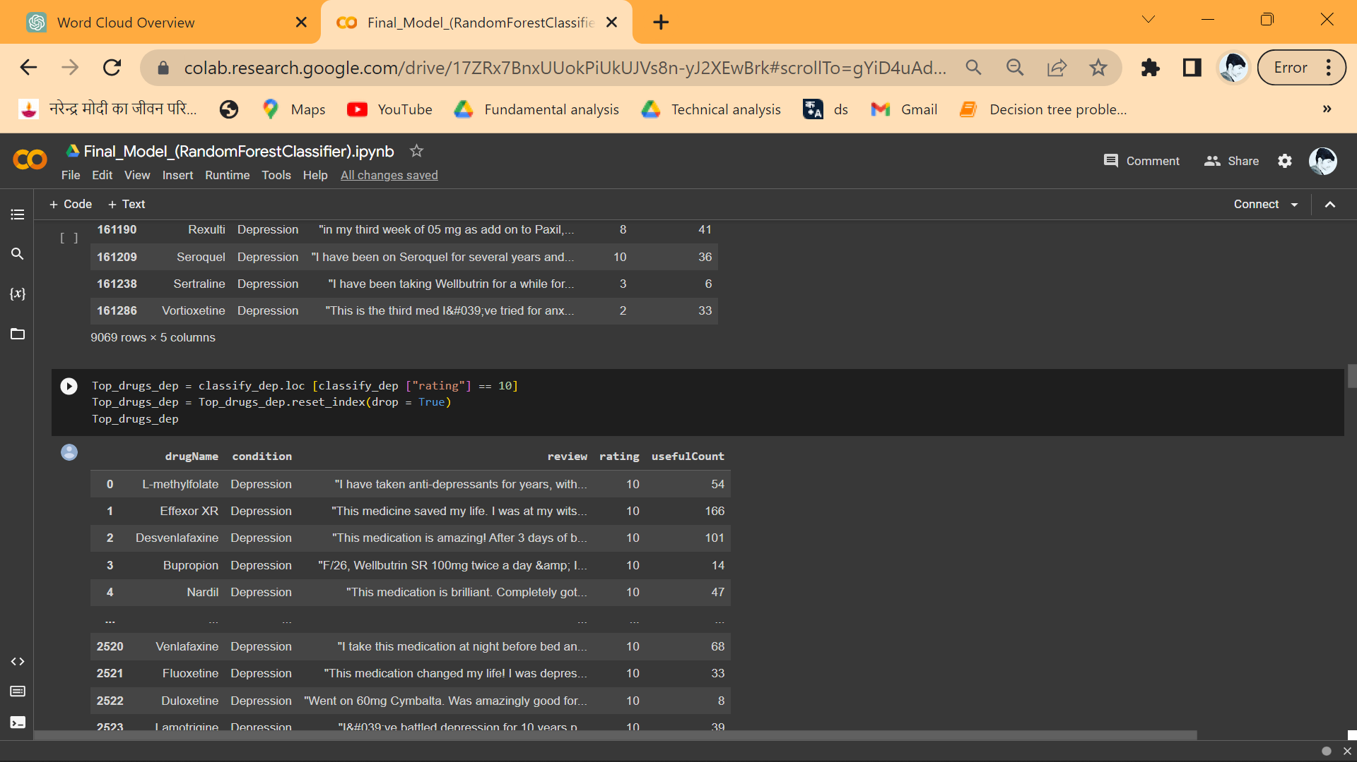
Top 10 drugs to be recommended for the user (For Depression)
Codes used

Slide 16
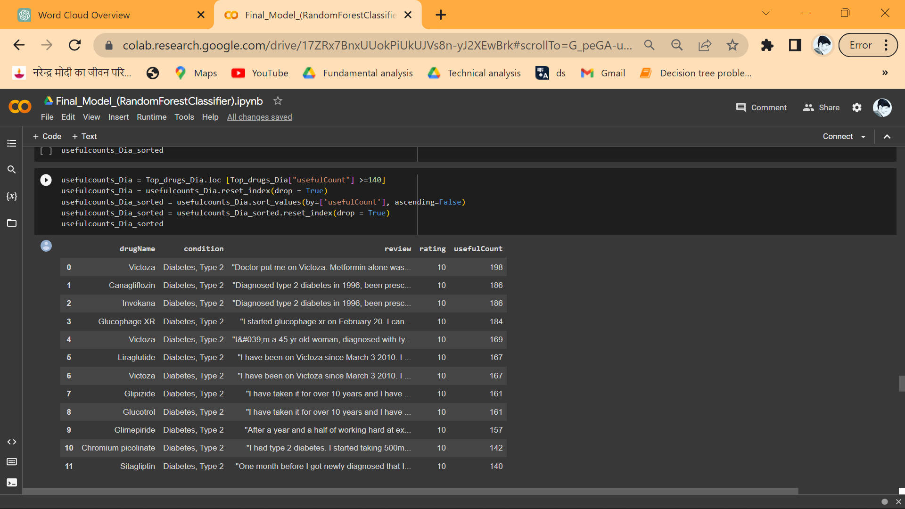
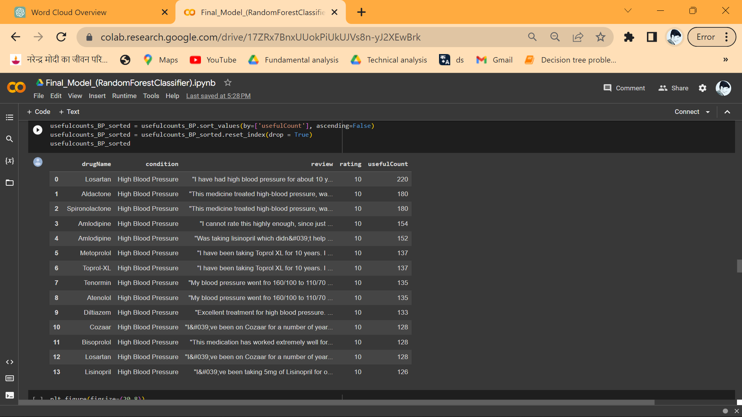
Similarly for High Blood Pressure, & Diabetes, Type 2
Top 10 drugs for Diabetes, Type 2
Top 10 drugs for High Blood Pressure

Slide 17
4. Text Preprocessing
In this step we performed text cleaning, it involves
Lowering the text
Removing stop words
Removing empty spaces and empty strings
Removing HTML tags and other related things
Removing special characters (?,!,# etc.)
Tokenization
Lemmatization
For this purpose we have used libraries like NLTK , re(Regular Expressions), string, BeautifulSoup, wordnetLemmatizer etc.

Slide 18
5. Feature Extraction
Two types of feature extractions methods we have used i.e.
BAG OF WORDS (with unigrams, bigrams and trigrams)
TF-IDF (Term Frequency - Inverse Document Frequency)
We have used countVectorizer,TfidfVectorizer from Sklearn library for feature extraction.

Slide 19
6. Model Building and Model Summary
To build the model, we used the extracted features as our input and the condition as our target variable.
Then we slitted the data into train(80%) and test data(20%).
As we know condition has 3 classes i.e. Depression, Diabetes Type 2 and High Blood Pressure. We trained different classification models including ensumbling technique.
We used the test data to find the performance of the models. As there was a huge imbalance in the target variable we have used F1-score as our matric rather than accuracy to know the performance of each models & finally for the selection model.
Here we used mostly sklearn, TensorFlow and Keras to build the Models.

Slide 20
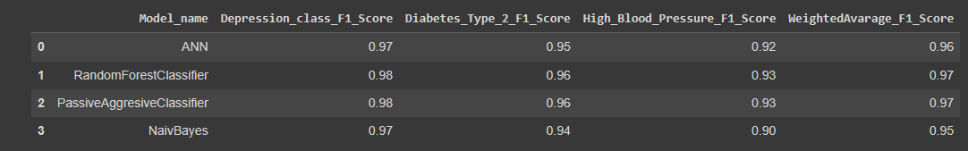
As we have used 4 models Artificial neural networks, RandomForestClassifier, Passive aggressive classifier, & naïve bayes. Random Forest & Passive Aggressive have same F1-scores, but we have specifically choosed RandomForestClassifier as our final model due to its robustness & flexibility. Then we saved the trained model for the Deployment.
Model Summary table:

Slide 21
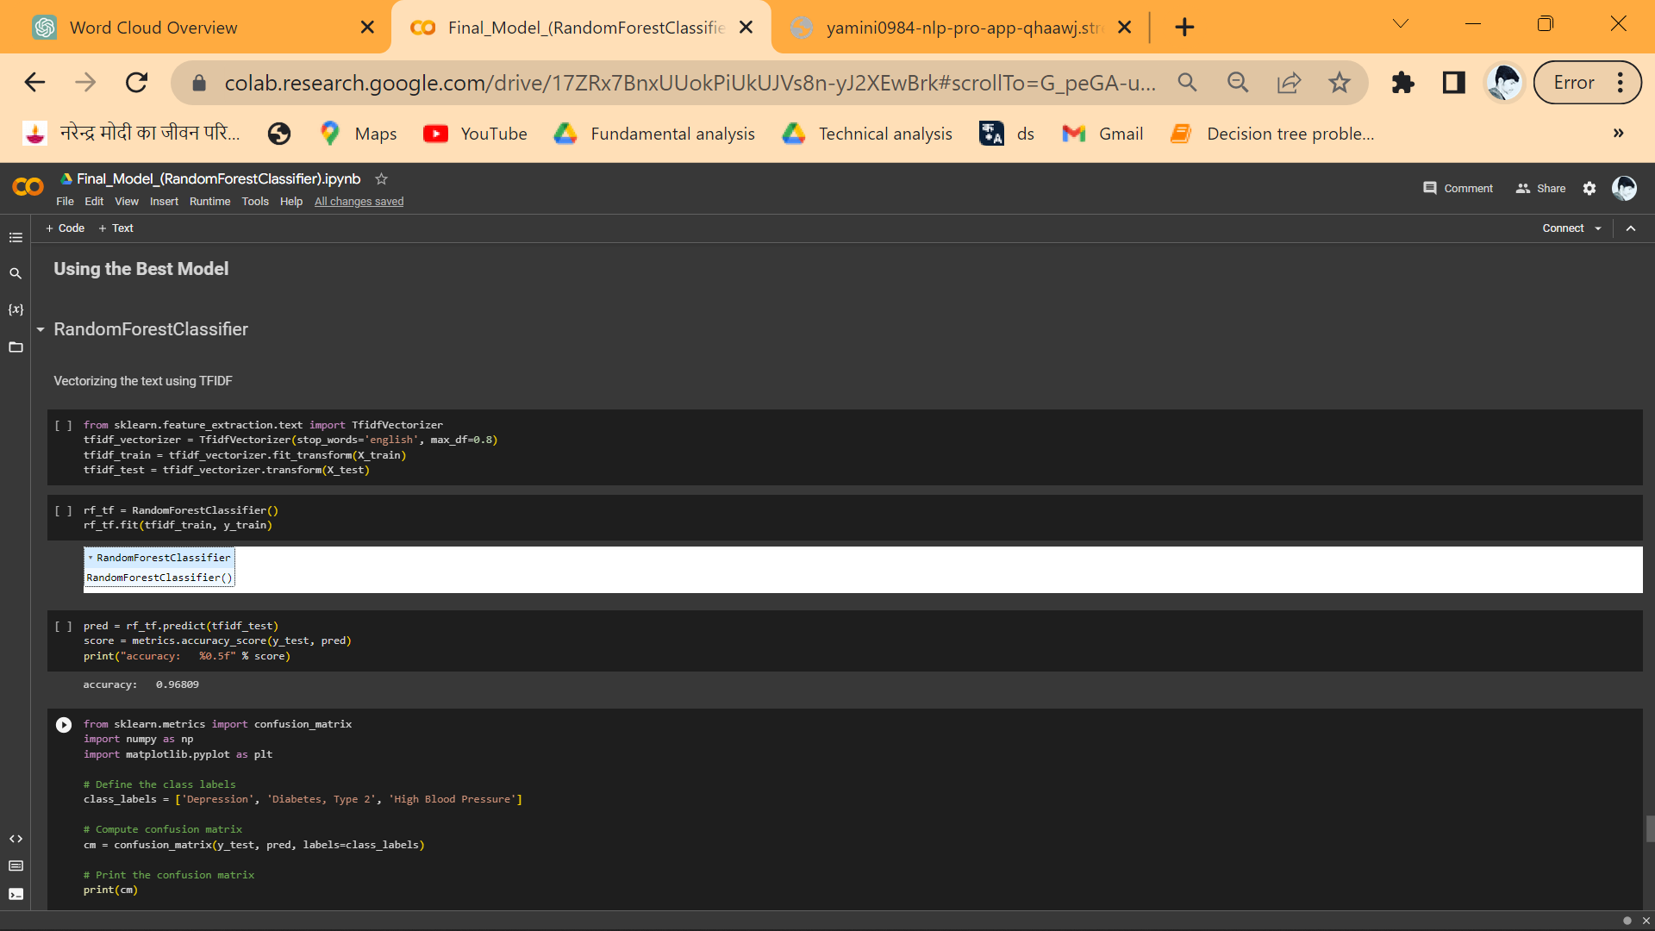
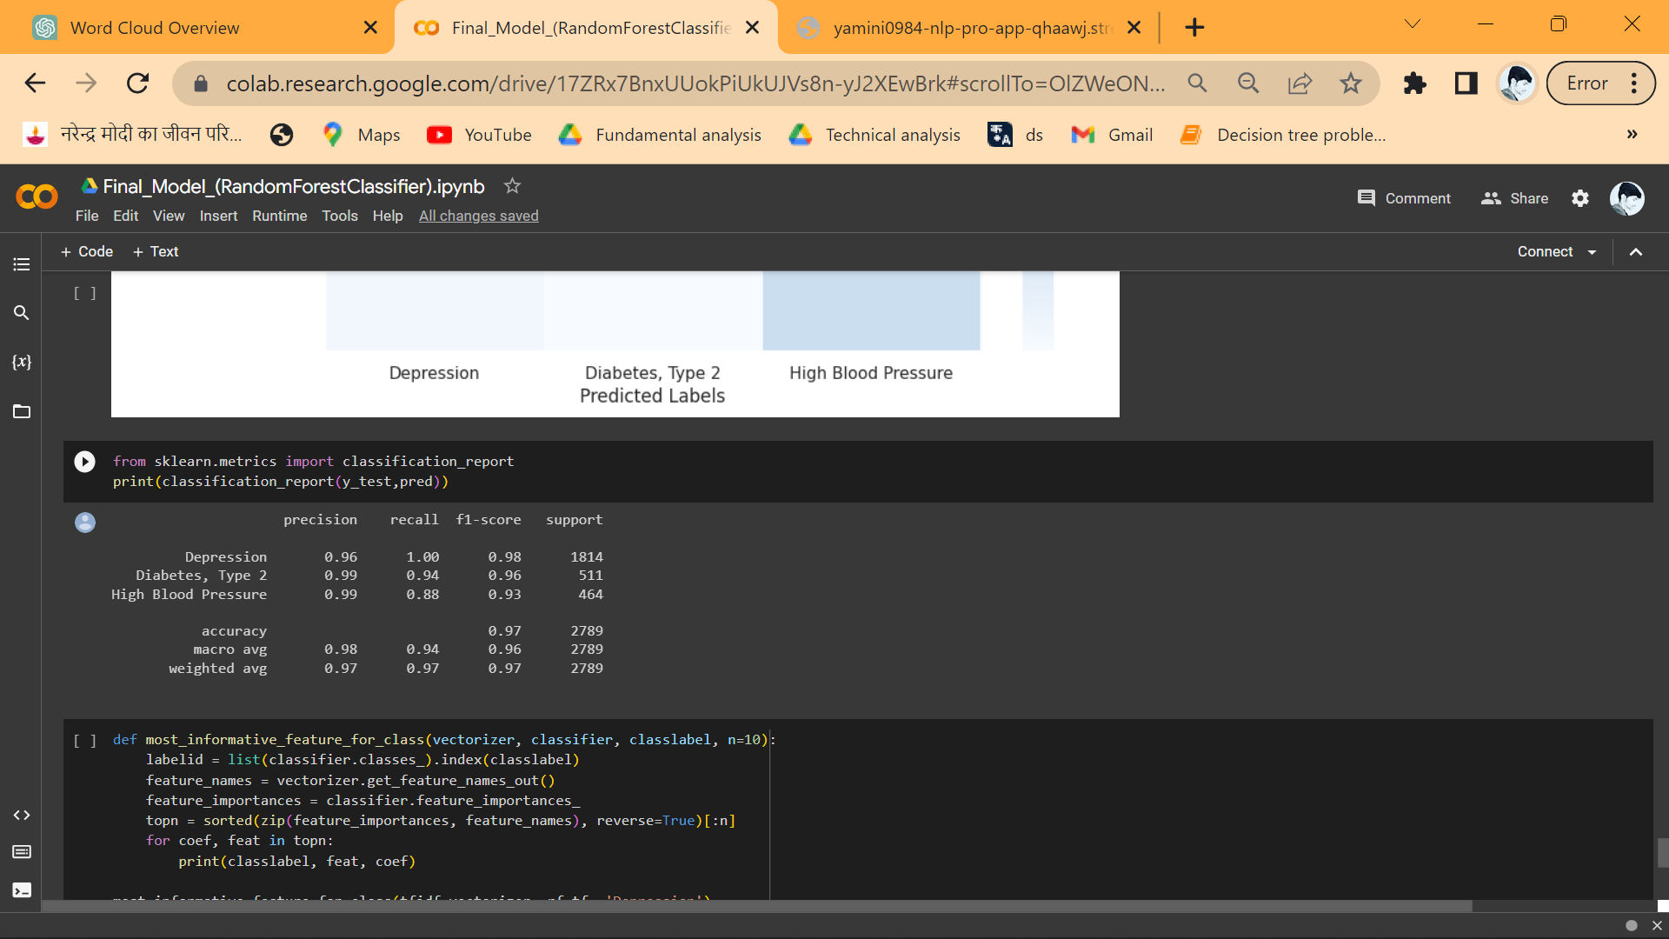

Slide 22
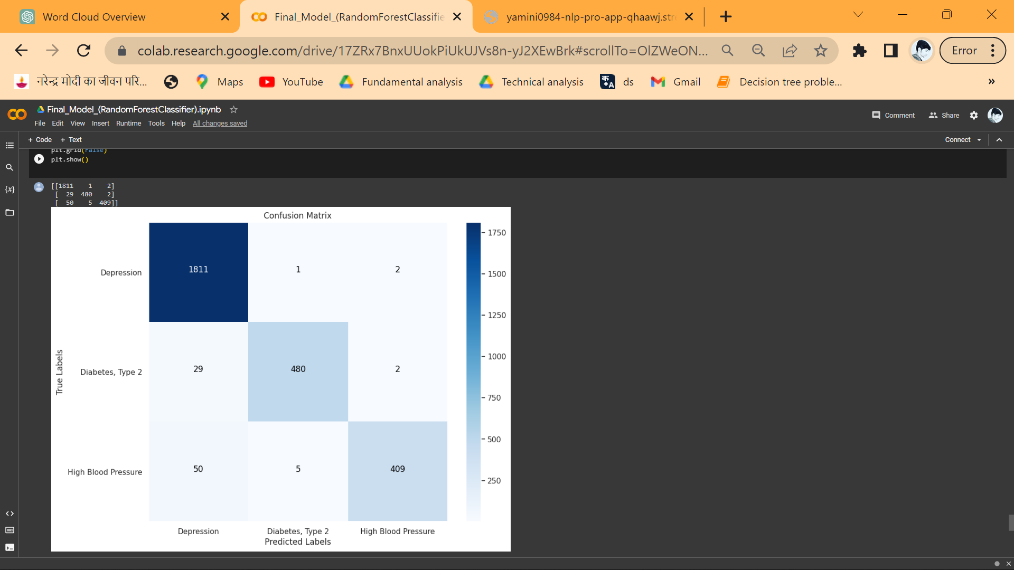
Confusion Matrix

Slide 23
7. Challenges Faced
As there was a huge imbalance in the data (within Target variable), we couldn't realia on standalone metric called accuracy instead we had to check precision, recall, F1-score, & weighted average as our metrics which was a quite challenging.
To find the most effective or the top drugs for a particular condition.
In model selection part, as we were facing same scores for the 2 models(Random forest classifier, Passive aggressive classifier) among the 4 models that we had performed and we were not able to decide what should be our final model, then we had to study about the models robustness and individually check the out puts by giving them the values to be predicted, by this we came to a conclusion that as Random forest classifier was an ensumbling technique & more powerful than Passive aggressive classifier, we decided to go ahead with Random forest classifier.

Slide 24
As there were a lot of verities in the vectorization techniques(Bag of words, bigrams, trigram, quad grams, 5–grams ,tfidf vectorizer, tfidf vectorizer using bigrams, tfidf vectorizer using trigram, tfidf vectorizer using quadgrams), we had build separate models for each verity of vectorization technique which took a lot of time and patience.
We were not able to perform hyper-parameter tunning for the models due to the size of the dataset.
In Artificial neural network to reduce overfitting condition we had to manually check the performance of the model by providing different hyperparameters and techniques used to handle overfitting.

Slide 25
8. Deployment
The final model is deployed using Streamlit web framework.
Link:
https://yamini0984-nlp-pro-app-qhaawj.streamlit.app/
Thank You

